Slide 1
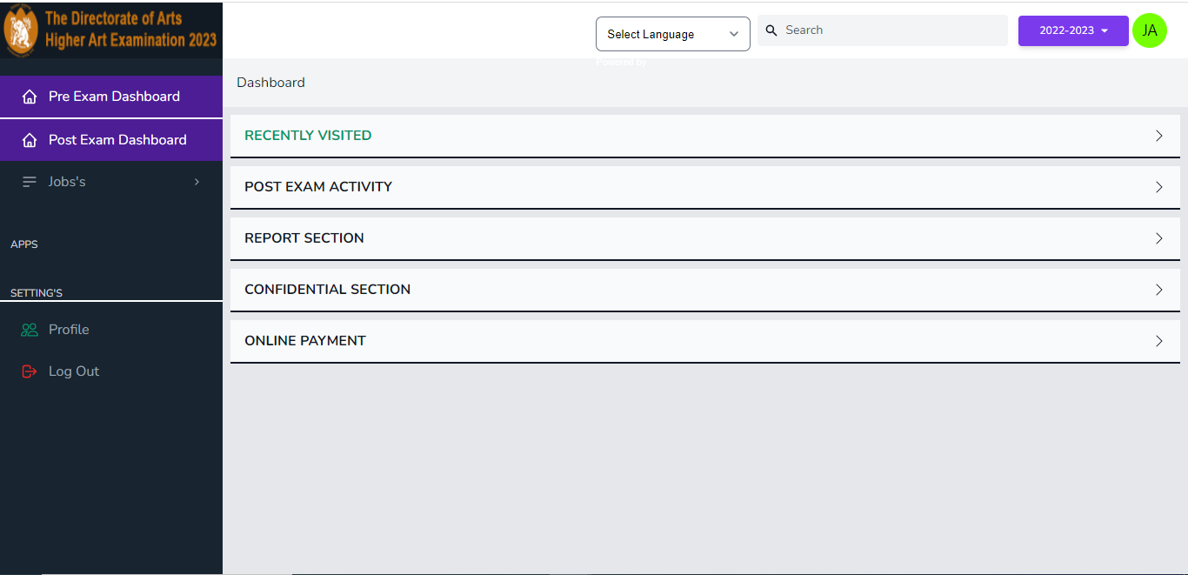
Open the website and login in case the website does not opens and show 404 error or something else. The type the full url https://doahae.ucanapply.com/.Click on the last option ONLINE PAYMENT.

Slide 2
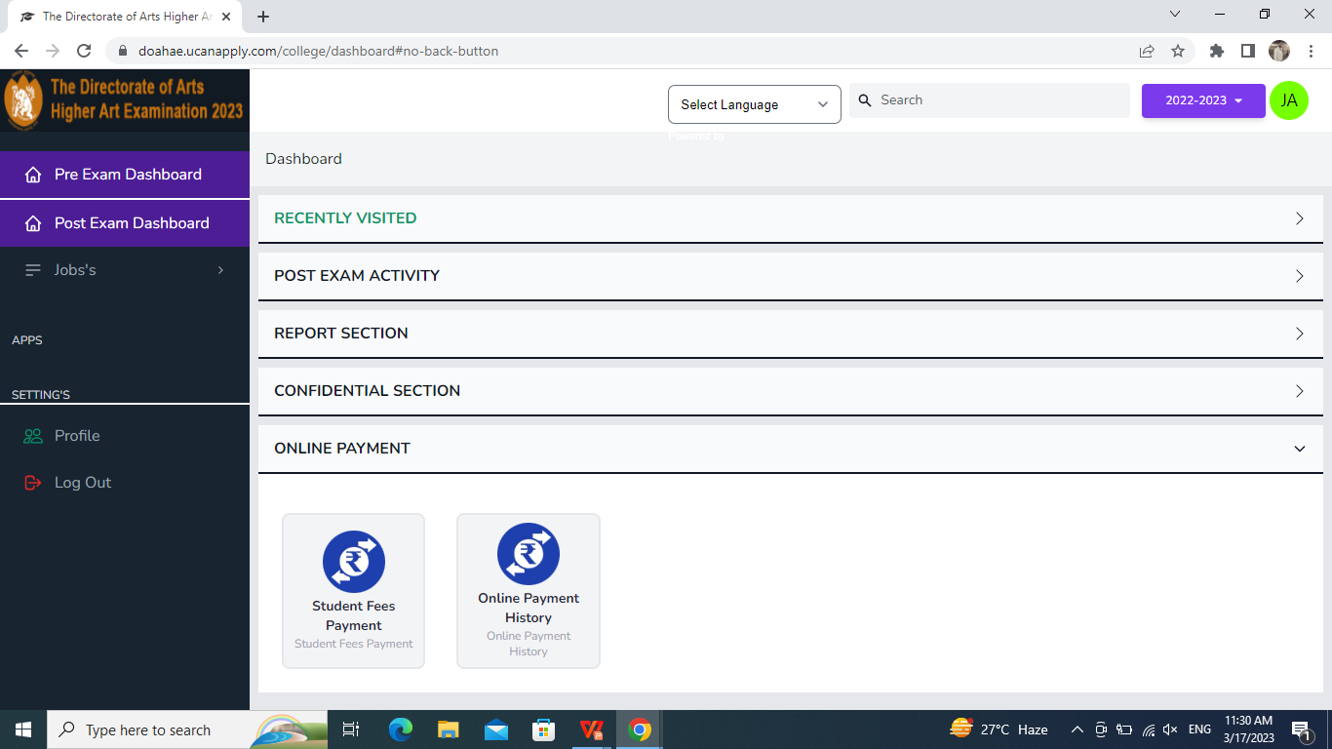
After clicking on the ONLINE PAYMENT this window will open and you have to click on STUDENTS FEES PAYMENT.

Slide 3
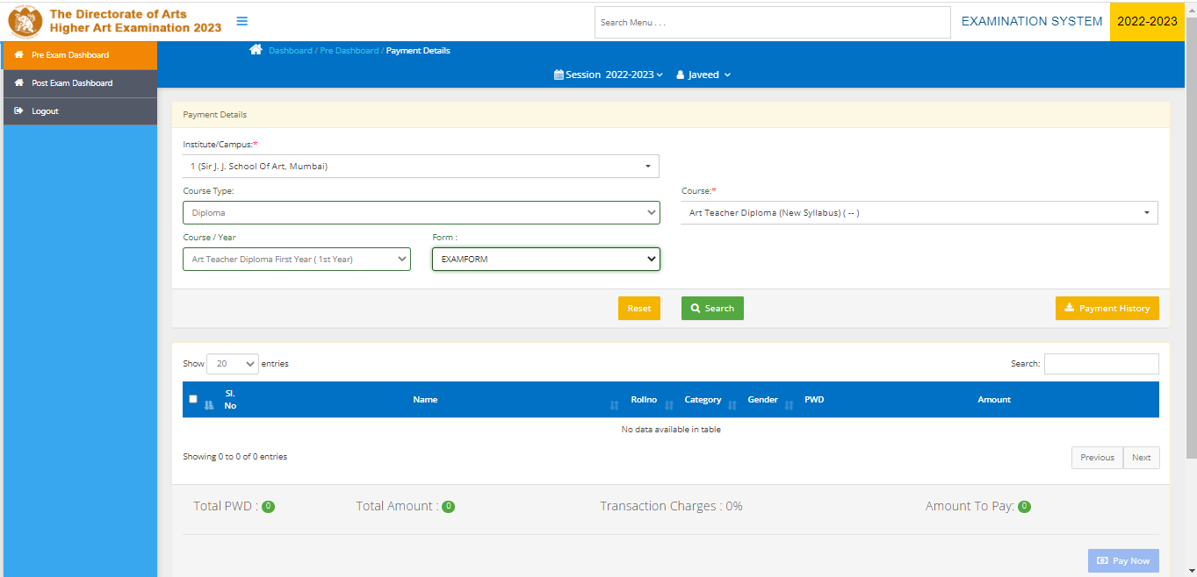
This page will open and here you have to fill up all the details of the college,course,Re-enter course etc.Then click on search to see the students list.

Slide 4
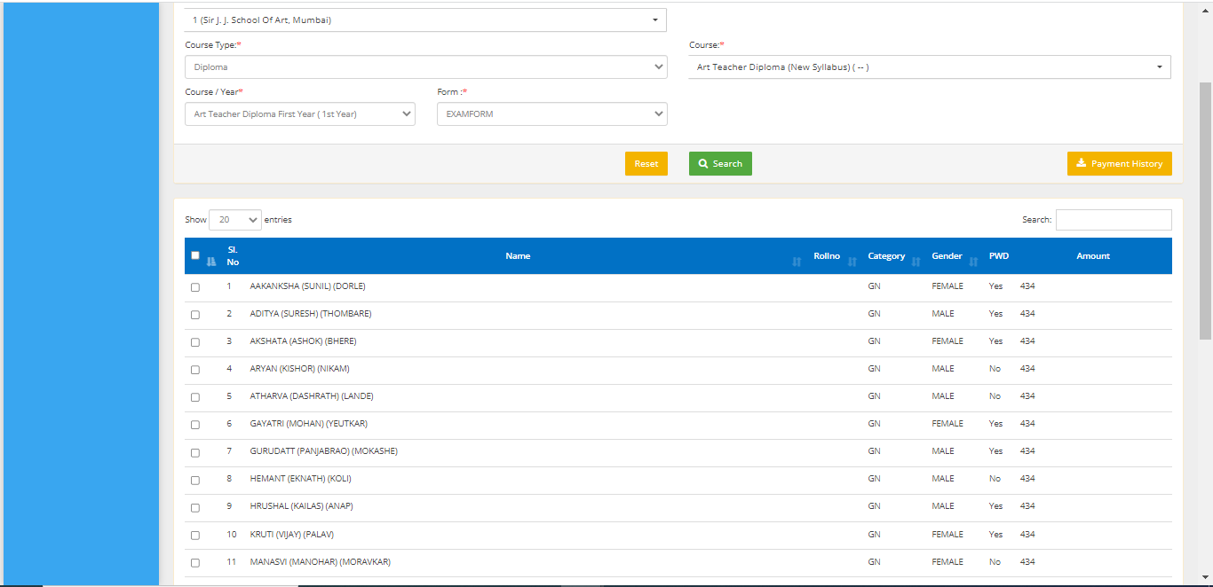
You will now be able to see the students lists as shown in below picture.Select the students by clicking on the box provided left to the name of the candidate,you may also select multiple names to make the Payment

Slide 5
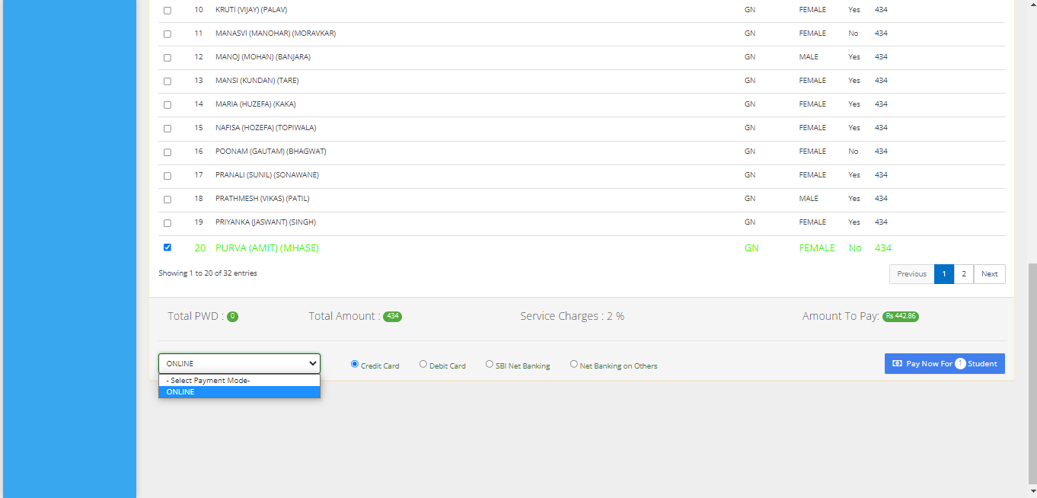
When the name of the candidate is selected you have to click on the boxex as shown in below picture. Then you have to click on the Pay now button to proceed for Payment.

Slide 6
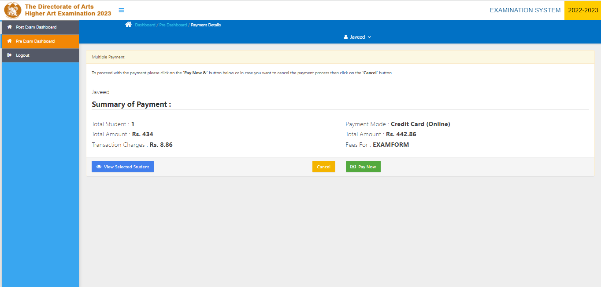
The below page will show te details of the Payment of the candidate.If you want to s ee the details or form of the candidate then you have to click on the View Selected Student. Then you have to click on the Pay Now box.

Slide 7
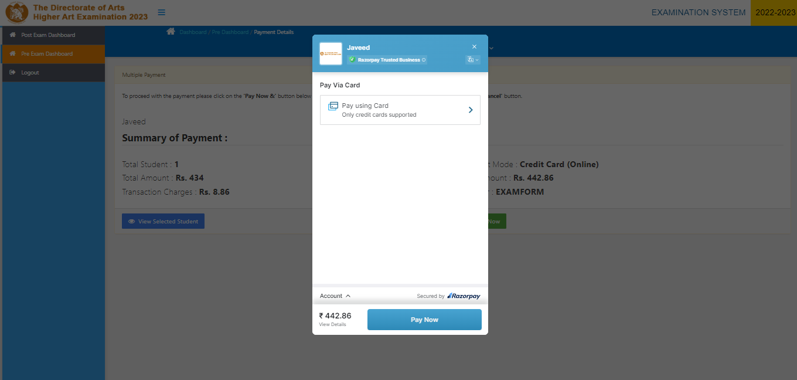
Here this Payment gateway will open where we can make the payment.

Slide 8
If you want to make the Payment using card you can fll the details and make Payment

Slide 9
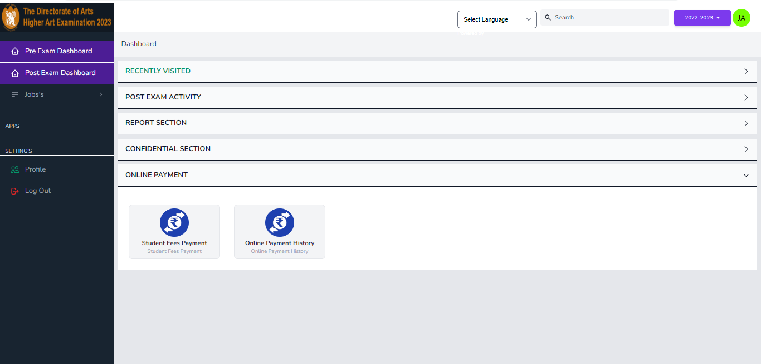
You may check the Payment details of the candidates using this option Online Payment History.

Slide 10
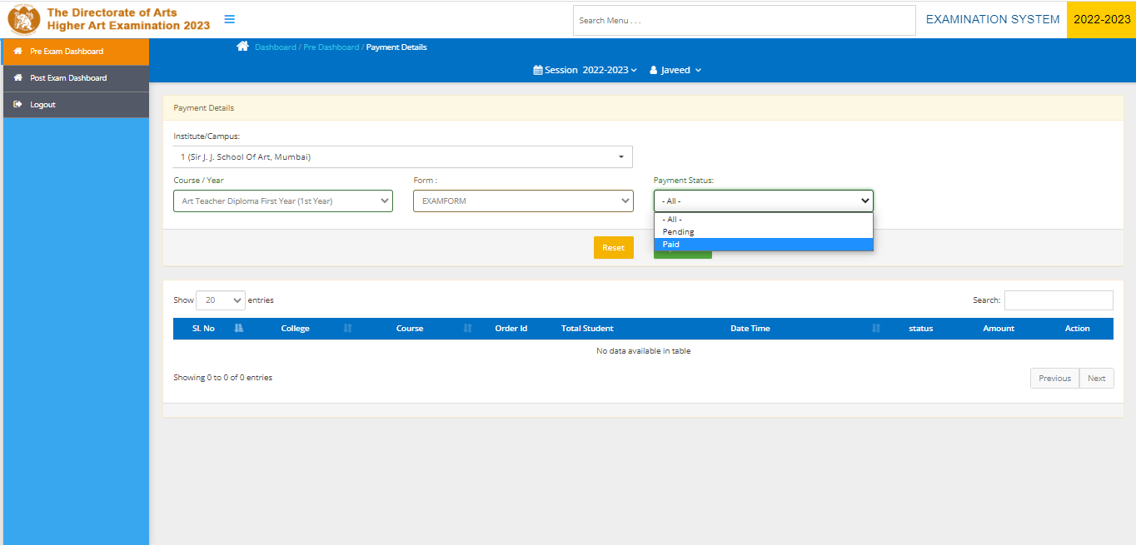
You have to fill in all the details of your college and name of the course of candidates inoreder to check the Payment status. We have both Paid and Unpaid option available. So we can easily check the complete details.Then click on search button to see the details below

